Slide 1
Health and Safety
Parkland

Slide 2
Trivia Question!!!!
Dr. Bonnie Henry says: Be kind be calm and be…?

Slide 3
Answer?
SAFE!

Slide 4
What’s the Same?
Learning new things
Meeting new people and enjoying your friends
You go to an amazing school!
We will keep you safe

Slide 5
What’s Different?
Staying with your Learning Group inside and outside
Recess and Lunch Schedule
Playing in specific areas – rotating
Using designated washrooms
You have your own learning space
More sanitizing & hand washing

Slide 6
Learning Groups
Your learning bubble
Same children & same classroom adults
School in a school

Slide 7
Trivia Question!!!!
Which students are in your Learning Group?

Slide 8
Answer…
Your class!!!!

Slide 9
There will be a Group A and Group B Schedule
Group A | Activity |  | Group B | Activity
9:00 | Start Time |  | 9:00 | Start Time
9:00-10:35 | Instructional Time |  | 9:00-11:00 | Instructional Time
10:35-10:50 | Recess - Outdoors |  | 11:00-11:15 | Recess – Outdoors
10:50-11:45 | Instructional Time |  | 11:15-12:25 | Eating & Instructional Time
11:45-12:15 | Lunch - Outdoors |  | 12:25-12:55 | Lunch - Outdoors
12:15-2:38 | Eating & Instructional Time |  | 12:55-2:38 | Instructional Time
2:38 | Dismissal Time |  | 2:38 | Dismissal Time

Slide 10
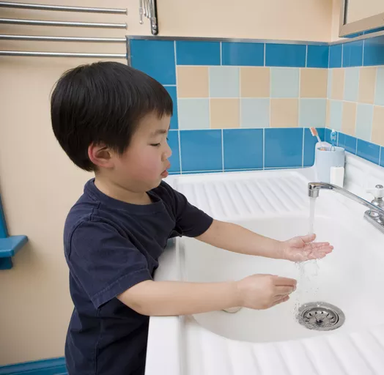
Handwashing Tips! We will Handwash…
Arrival, before and after breaks, before you go home
Before and after eating
Before and after using any space utilized by other groups (e.g. gym)
After using the toilet & restroom
After sneezing or coughing into hands
Whenever hands are visibly dirty

Slide 11
Trivia Question!
What is a good song to sing while washing your hands?

Slide 12
Songs? How long should I sing?
Twinkle, Twinkle Little Star
Happy Birthday x 2
Others???

Slide 13
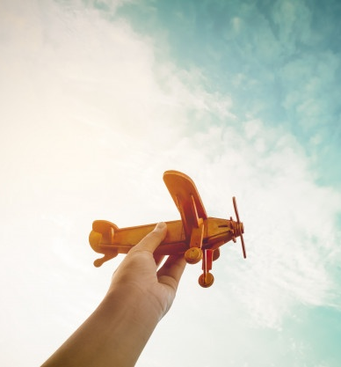
At Parkland You Will Still…
Be Here
Be You
Belong

Slide 14
What is Physical Distancing?
How far is that? Volunteer time!
Keeping 2m apart from other people

Slide 15
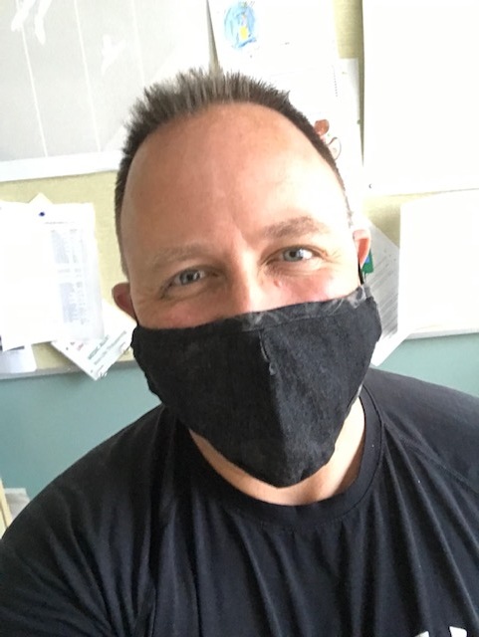
Who Might Wear a Mask at Parkland?
Adults in the hallways and in our shared spaces like the gym
Adults who come into your classroom
Adults who are teaching and supporting your learning spaces
Anyone who wants to wear a mask can!!!

Slide 16
When do I wear a mask if I choose to?
Anytime you want
When physical distancing is hard or impossible
Maybe the hallway

Slide 17
A Safe Day in the Life at Parkland!
Meet your teacher at your meeting spot
Enter your classroom and wash/sanitize your hands
Put away your belongings
Go to your learning space
Get ready to learn!

Slide 18
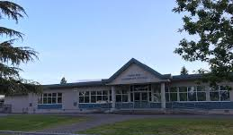
Meet your teacher at your meeting spot
Always outside and at the same spot

Slide 19
Enter & Hand Wash/Sanitize!

Slide 20
Now put your belongings away and go to your desk or table!

Slide 21
Get ready to learn and have a great day!

Slide 22
To help keep me keep my distance at school
I will see arrows to show me the direction to walk.

Slide 23
I will also see
Floor decals to show me where to wait

Slide 24
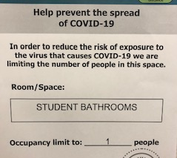
If I use the washroom…
I go to my designated washroom
There is only one person at a time using it

Slide 25
We will play in Play Zones

Slide 26
Play Zones
My teacher will bring me to and pick me up from the play zone
I will line up to enter and exit the play zone
I will need to stay 2 M apart from the Parkland learners in the other Learning Groups
There will be a supervisors outside to help me

Slide 27
What are 2 Things We Never Share?

Slide 28
What are 2 Things We Never Share? Food School Supplies

Slide 29
Trivia Time
When Can I wear a mask?

Slide 30
Trivia Time
If I have to cough or sneeze, I do it…
Into my arm
Into my hand
Into the air

Slide 31
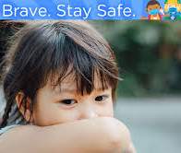
My Arm
Let’s practice

Slide 32
Parkland Reminders
Wash your hands often
Avoid touching your face
Stay in and with your learning group
Keep a safe distance

Slide 33
And Always Stay Home if You are Sick
If ever you feel sick, tell an adult and we will help you

